Slide 1


Android Lecture #1
Android Introduction
and Install

Slide 2


Index
Android Introduction
Android Feature
Android Version Evolution
Android Install
Android Environment Path Set Up
Android Studio Install
Application Creation
USB Driver

Slide 3

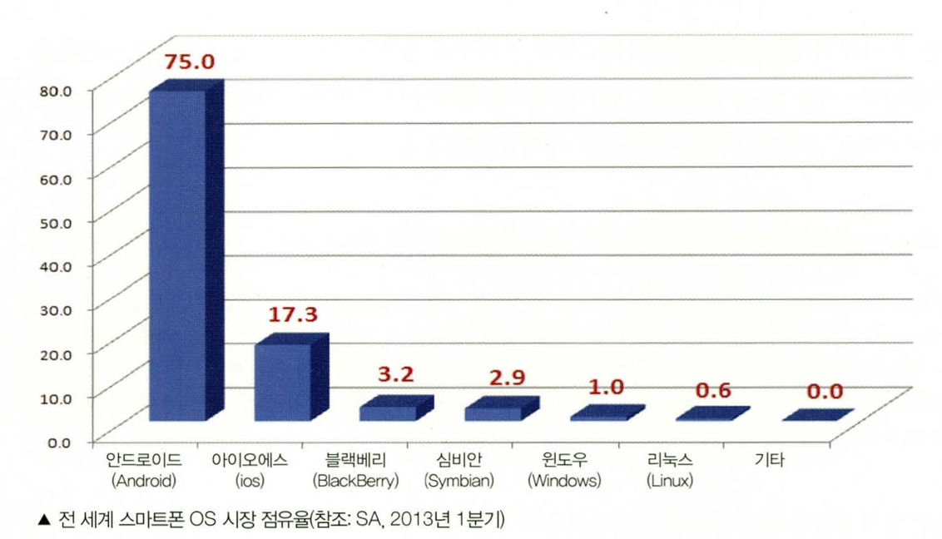
1. Android Introduction
Android
Similar with human
Mobile operating system
Google took over

Slide 4

2. Android Feature
Component
Free
Outstanding performance
Base on Java
Open Source

Slide 5
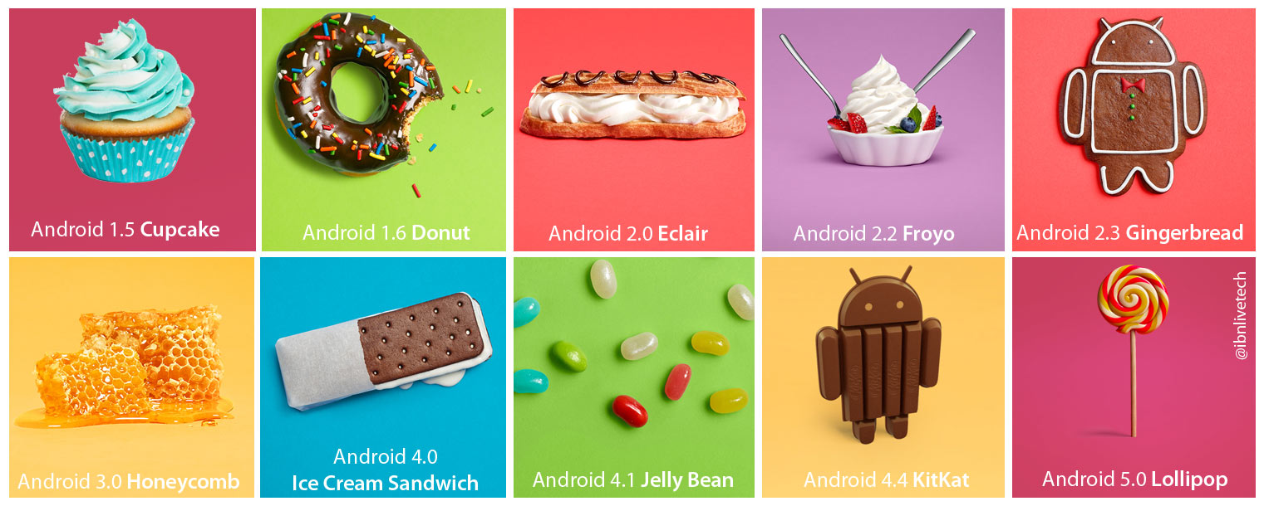
3. Android Version Evolution
Version Evolution Picture

Slide 6
4. Android Install
1. JDK(Java Develop Kit) install
2. Android studio install
3. SDK(Software Develop Kit) install

Slide 7
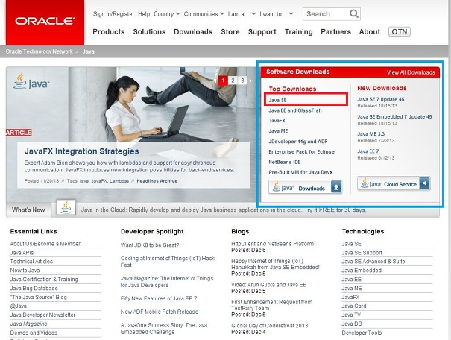
5. Android Environment Path Set Up
Java Install
JAVA
http://www.oracle.com/technetwork/java/index.html

Slide 8
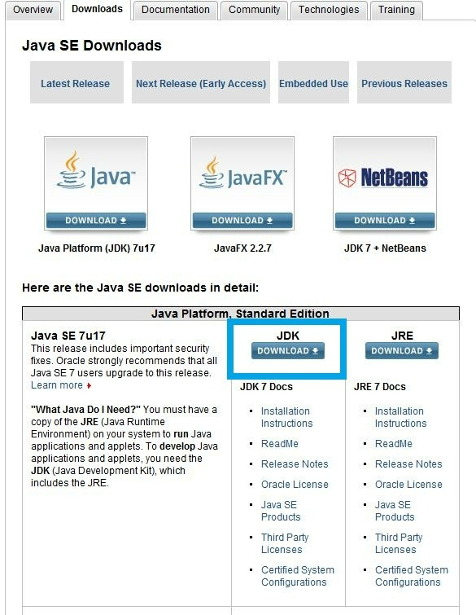
5. Android Environment Path Set Up
Java Install
JDK :
Java Develop Kit
JRE :
Java Routine Environment

Slide 9
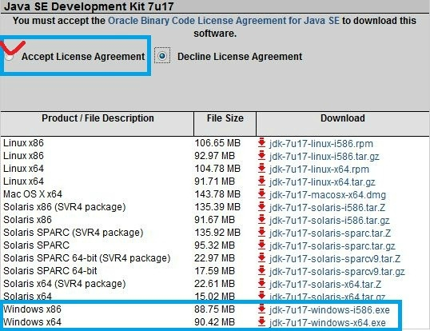
5. Android Environment Path Set Up
Java Install
Your type

Slide 10
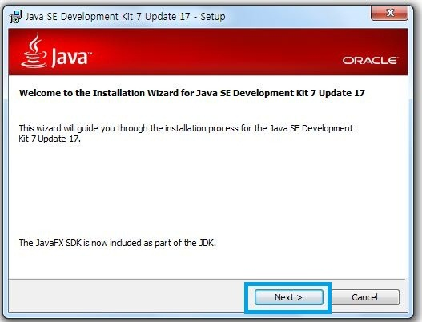
5. Android Environment Path Set Up
Java Install

Slide 11
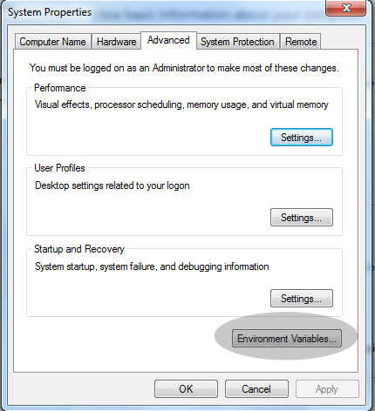
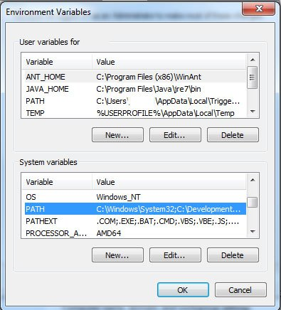
5. Android Environment Path Set Up
Java Environment Path Set Up
Start -> Computer -> Property -> System Set Up -> Environment Variable

Slide 12
5. Android Environment Path Set Up
Java Environment Path Set Up
JAVA_HOME – C:\Program Files\Java\jdk1.7.0_15
PATH – %JAVA_HOME%\bin;

Slide 13
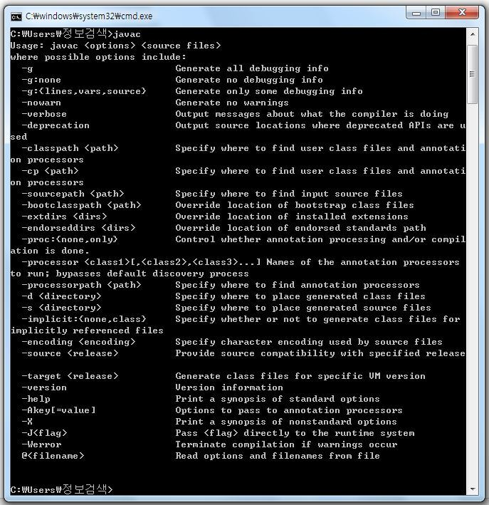
5. Android Environment Path Set Up
Java Environment Path Confirmation
Write javac

Slide 14
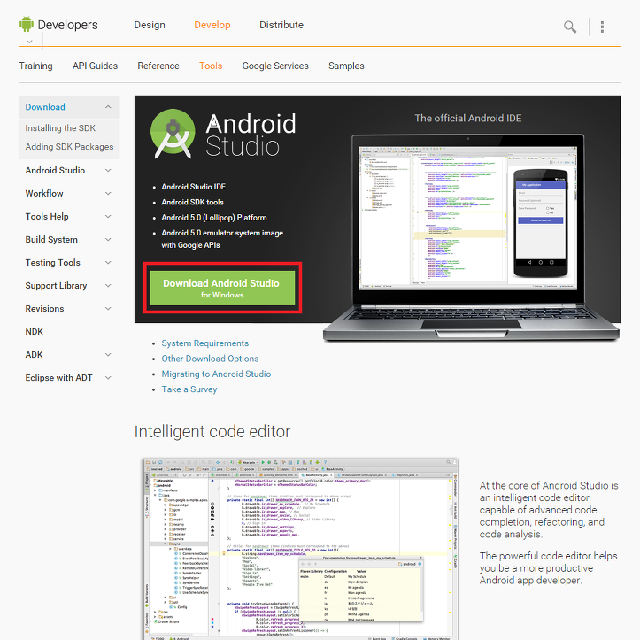
6. Android Studio Install
Android Studio Install
Android Studio
http://developer.android.com/sdk/index.html

Slide 15
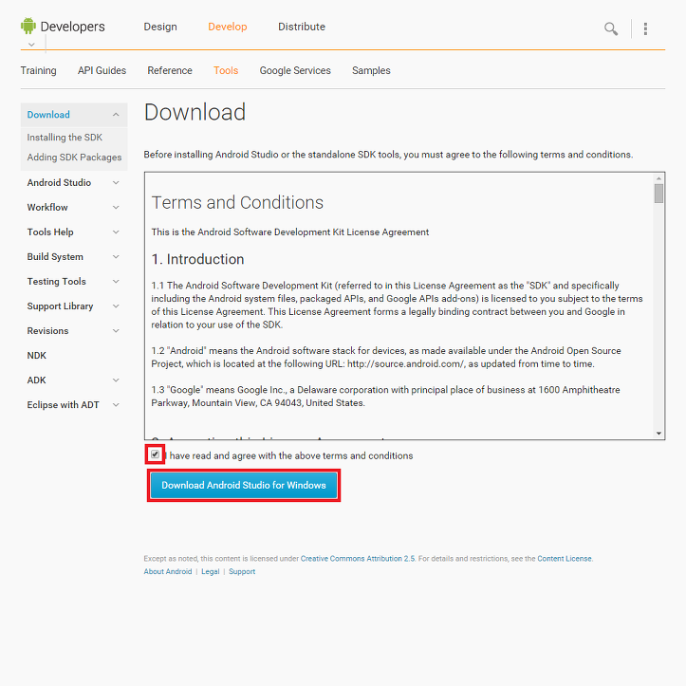
6. Android Studio Install
Android Studio Install

Slide 16
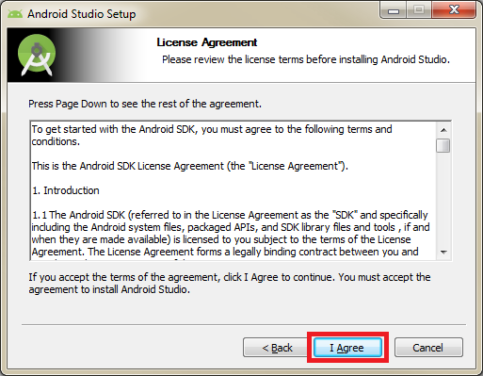
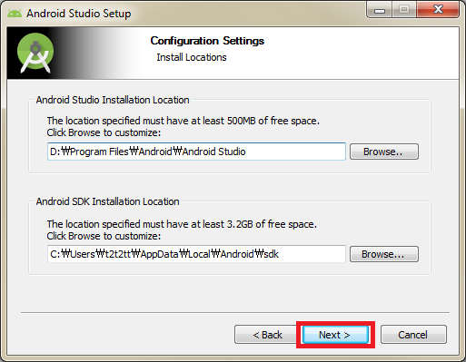
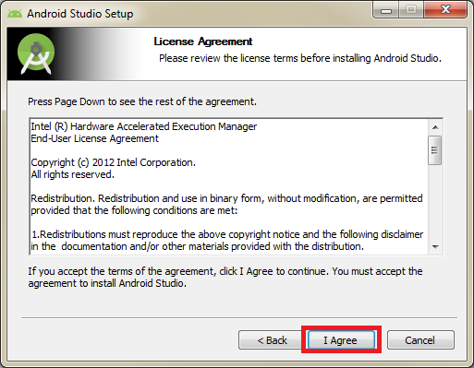
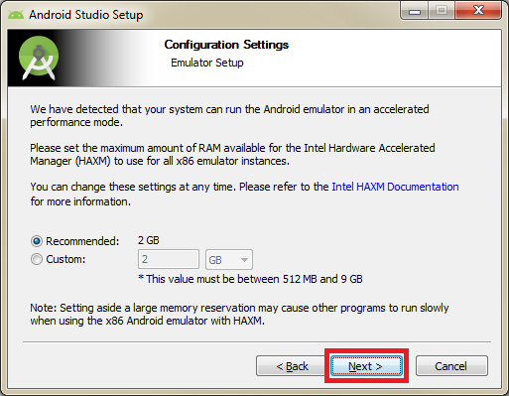
6. Android Studio Install
Android Studio Install

Slide 17
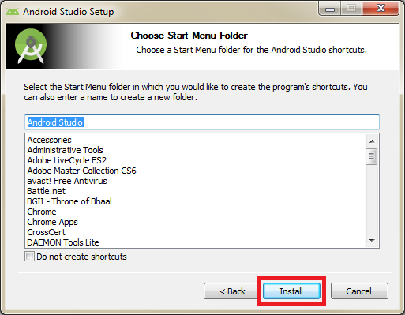
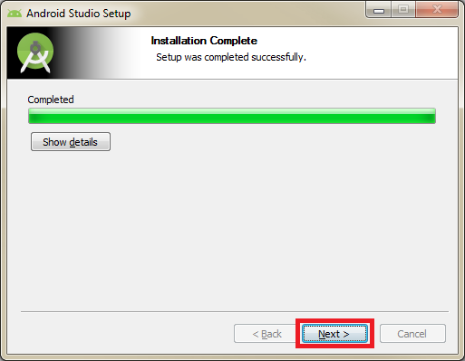
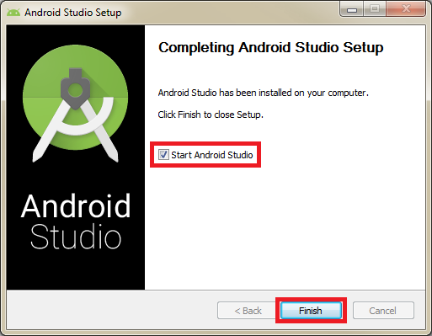
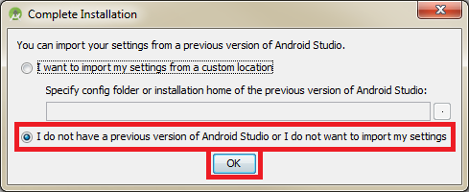
6. Android Studio Install
Android Studio Install

Slide 18
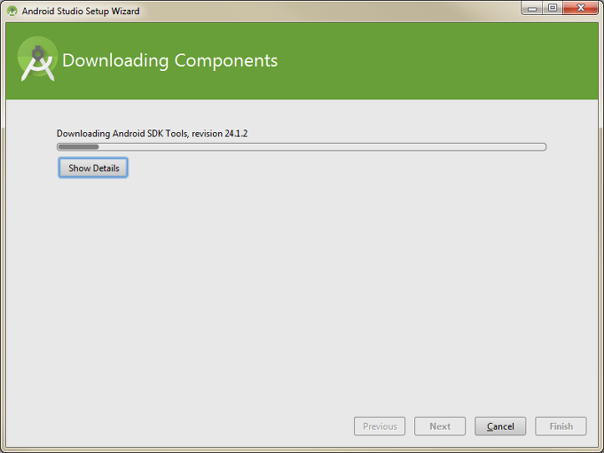
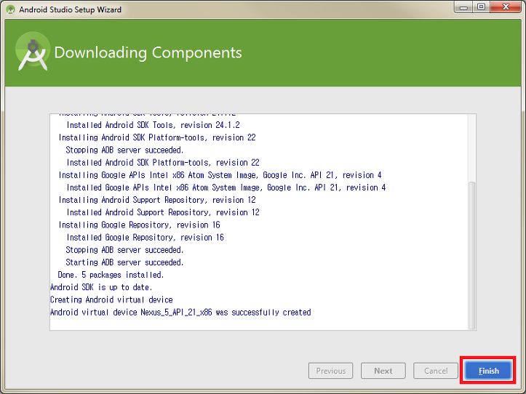
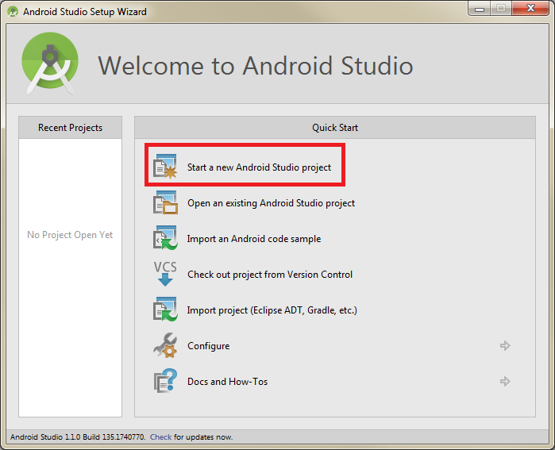

6. Android Studio Install
Android Studio Install

Slide 19
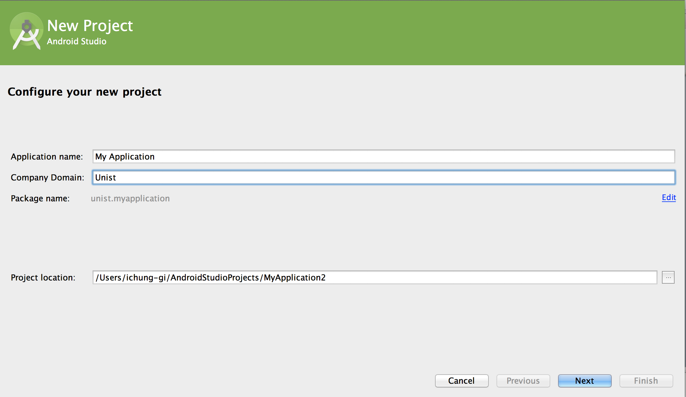
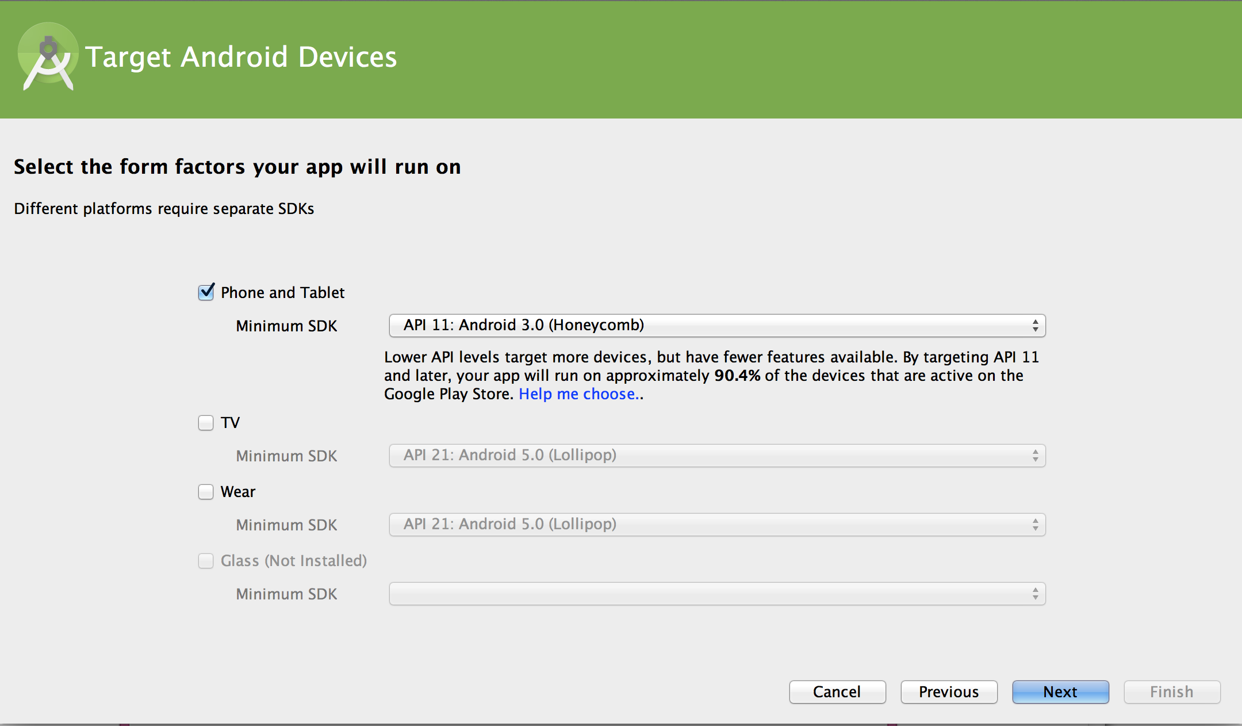
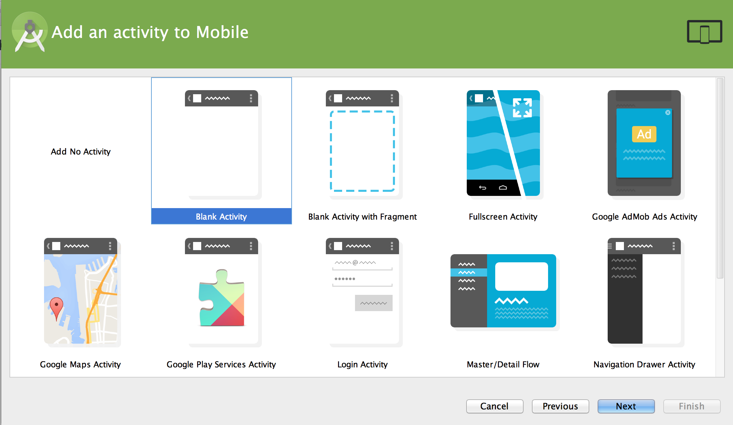
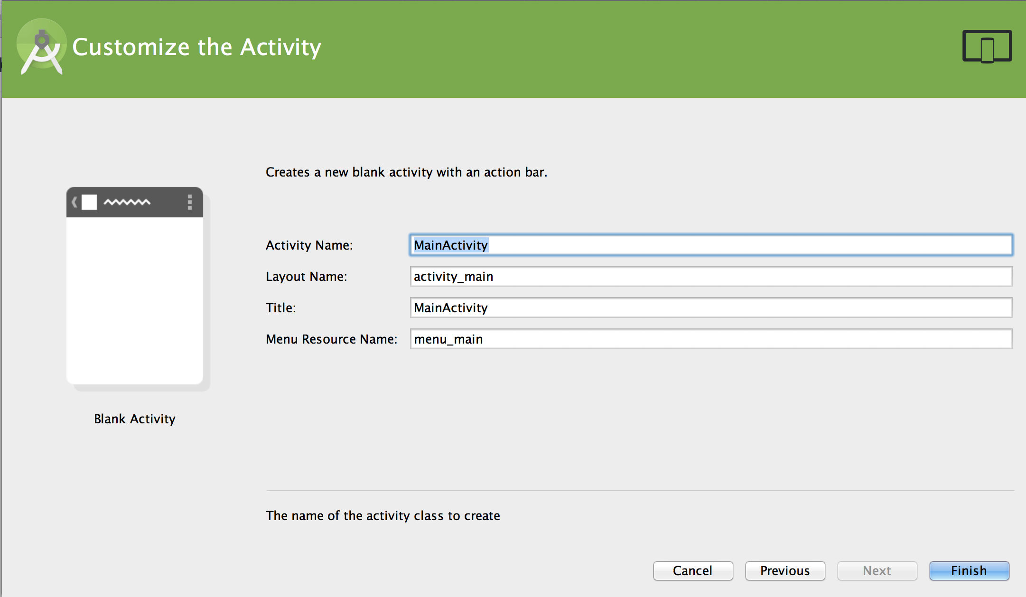
7. New Project
Project Creation
Write app name and domain
Choose minimum API level
Choose activity
Activity and layout

Slide 20
8. SDK Install
Android Studio Component
SDK Manager
AVD Manager
Load
Running
New

Slide 21
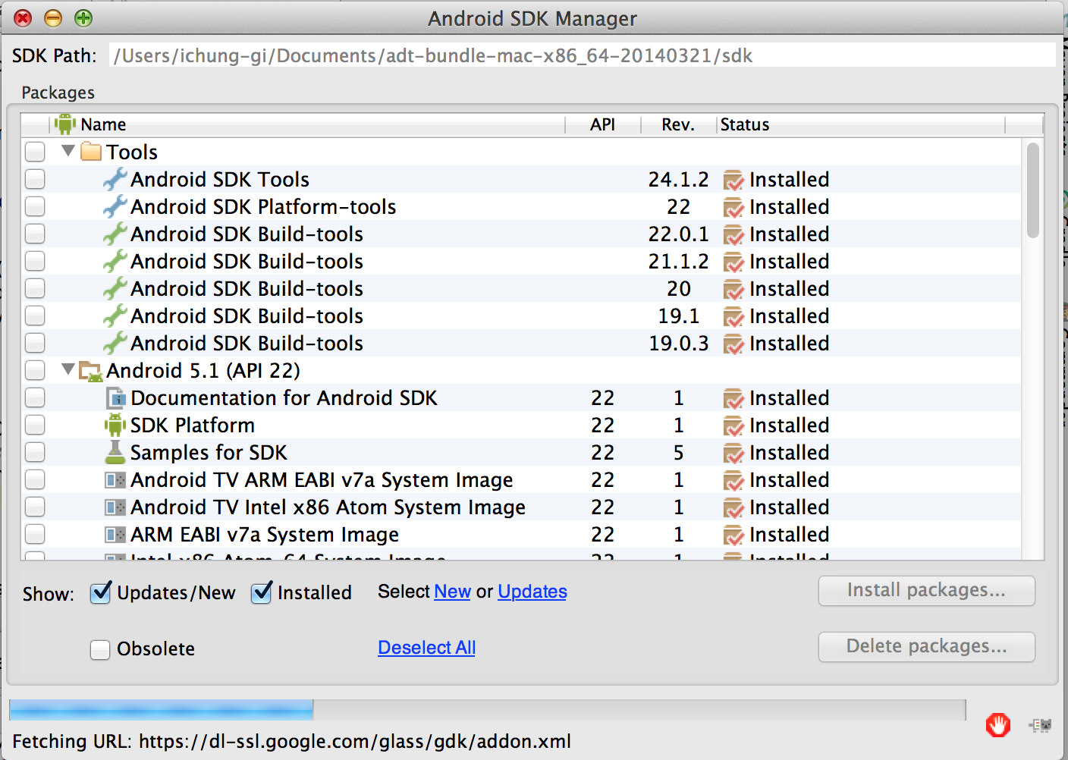
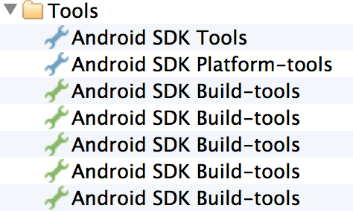
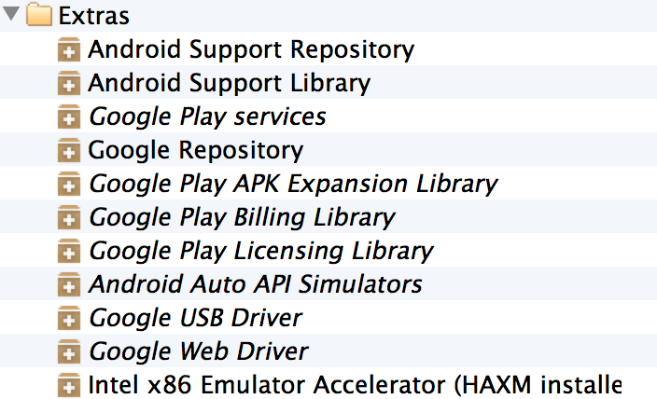
8. SDK Install
Required SDK Install
Tools
Extras

Slide 22
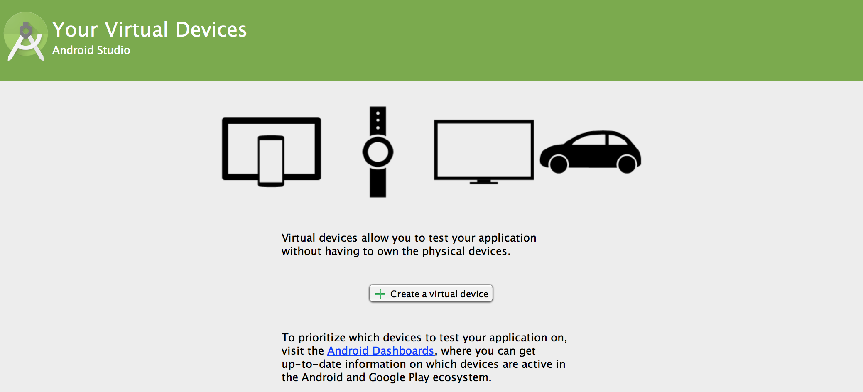
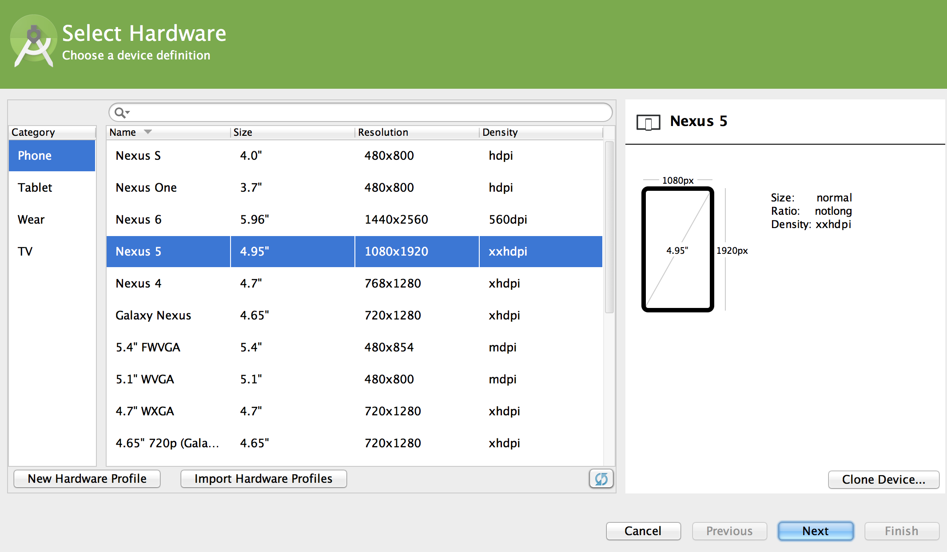
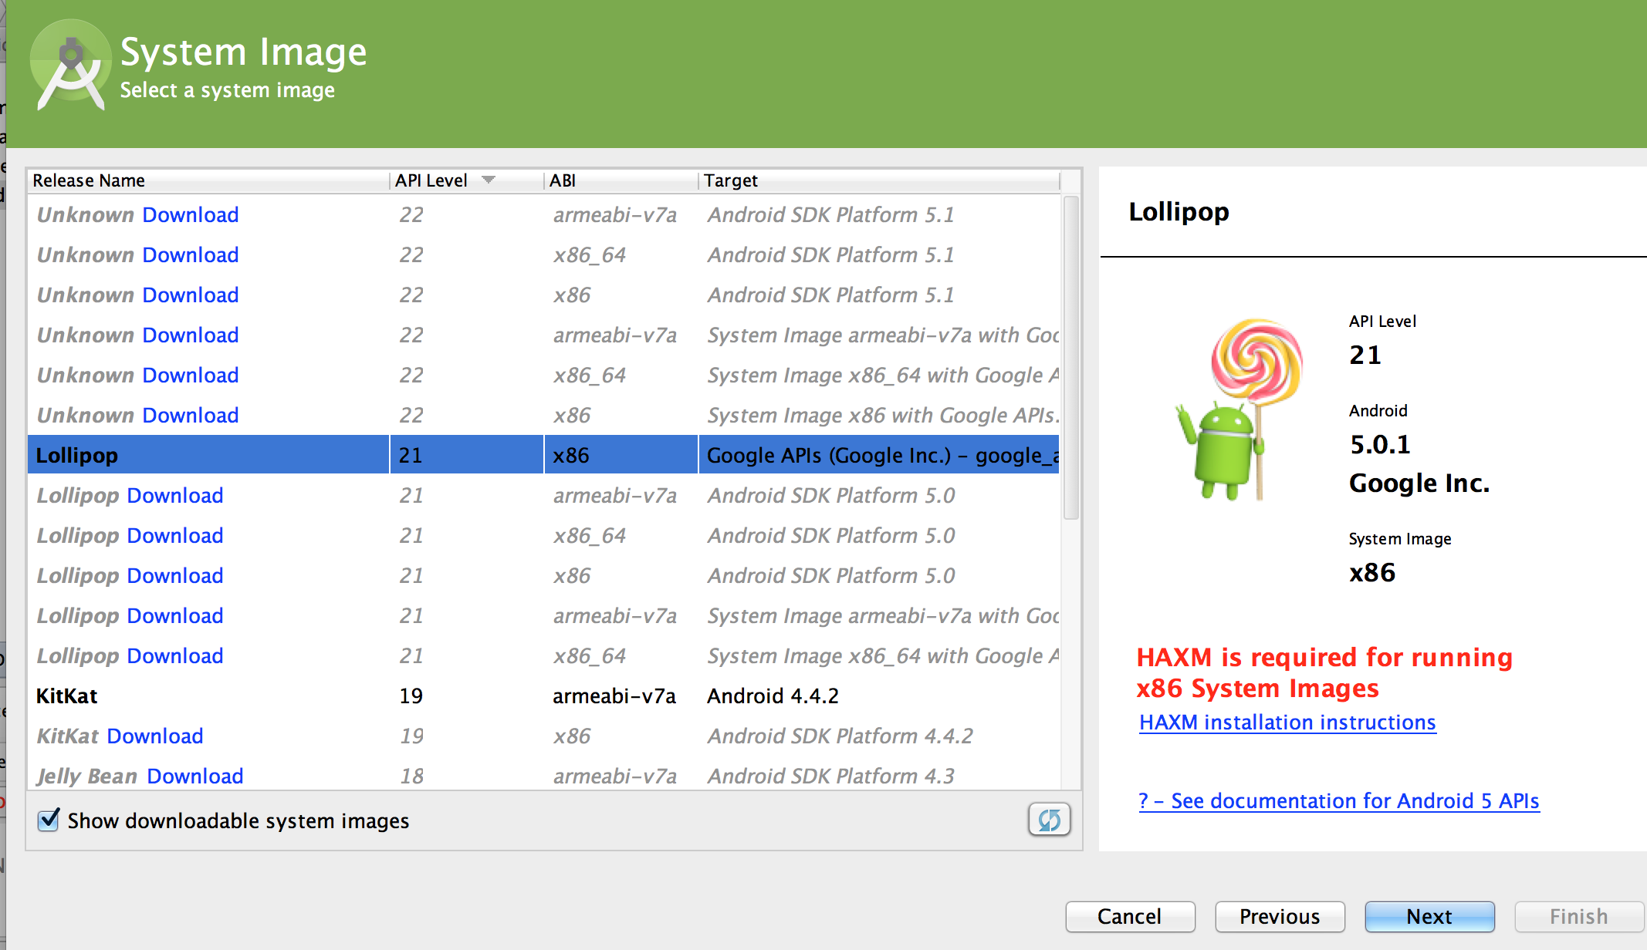
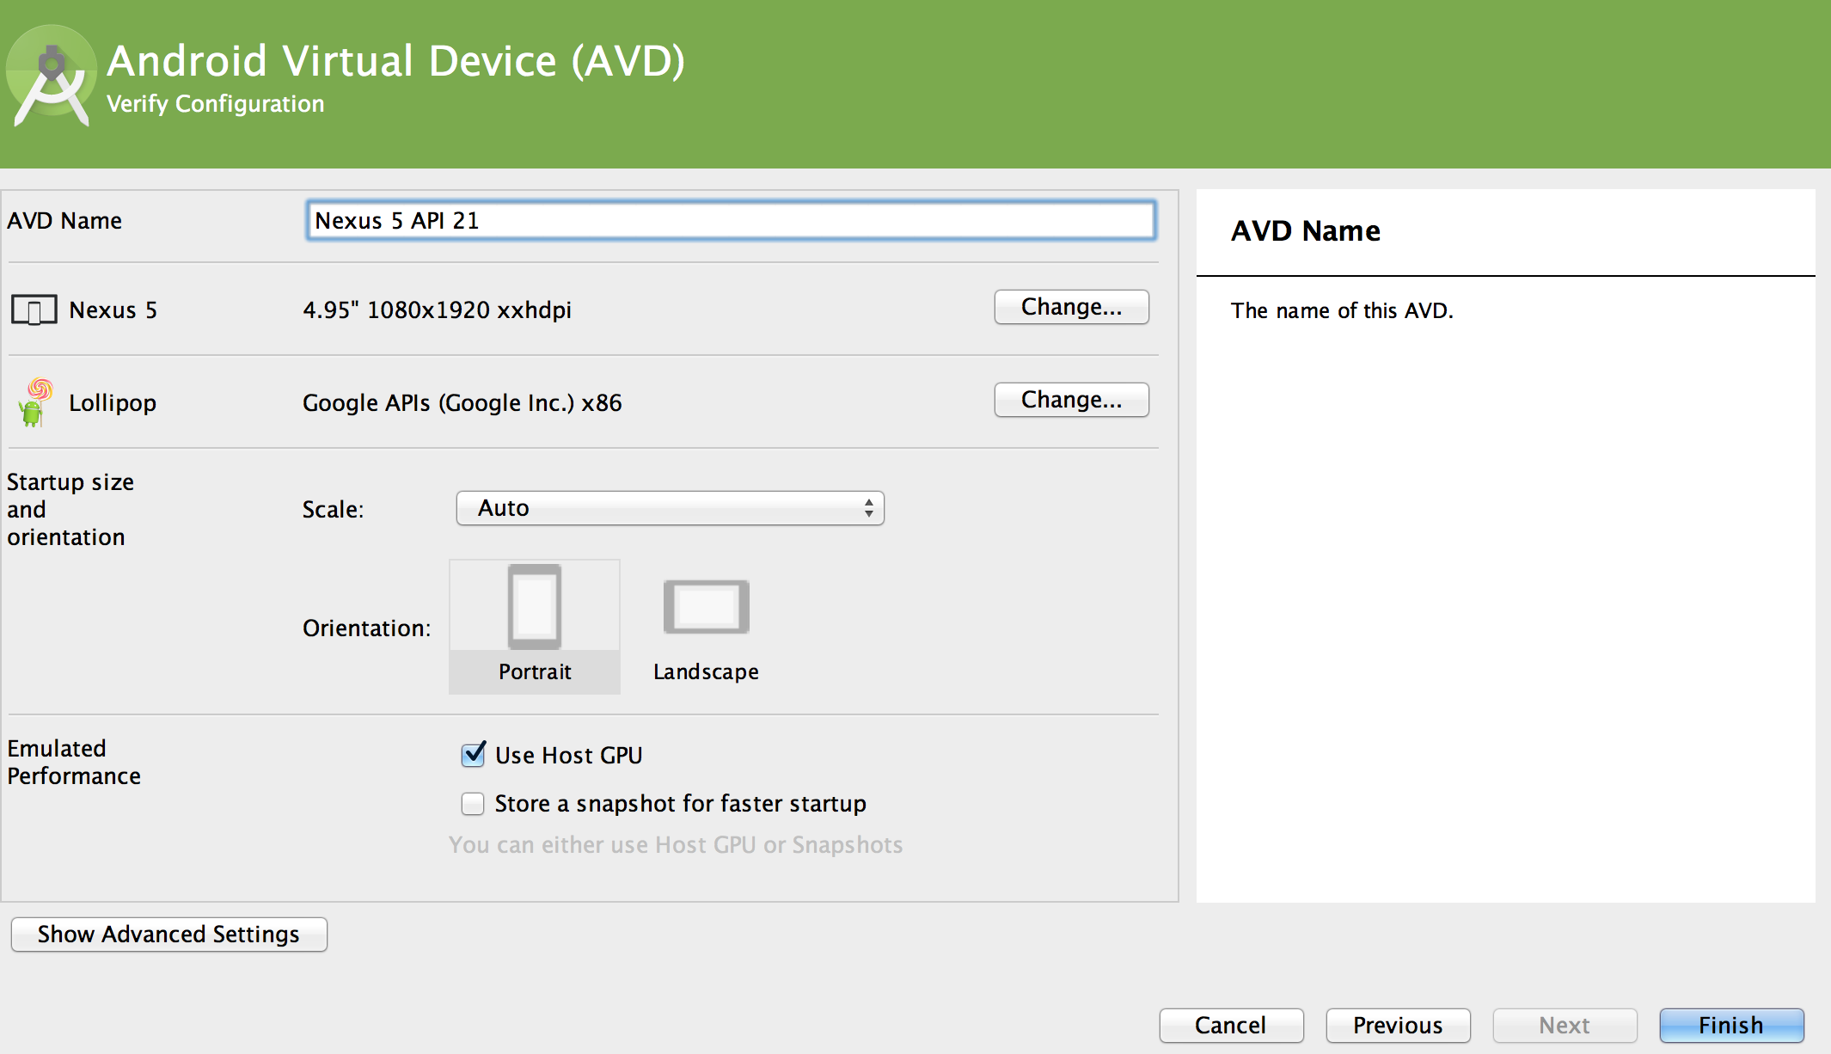
8. SDK Install
AVD Creation
Create virtual device click
Choose device
Select android version
Choose AVD name

Slide 23
Thank you!

